Slide 1
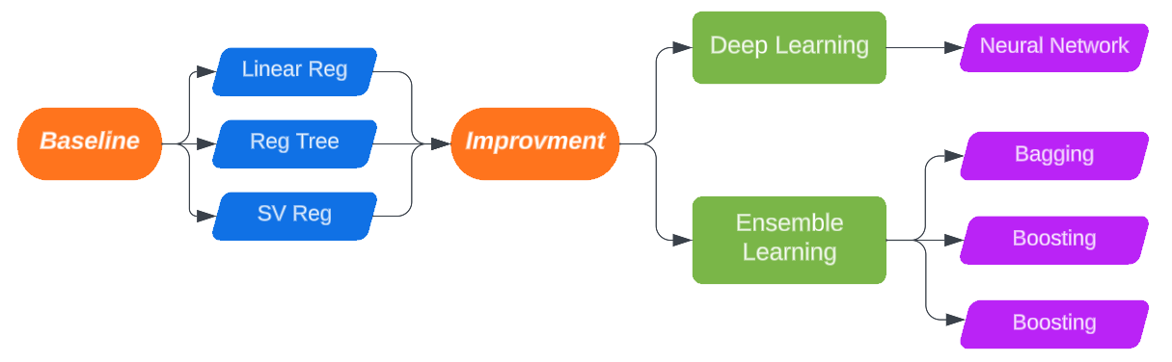
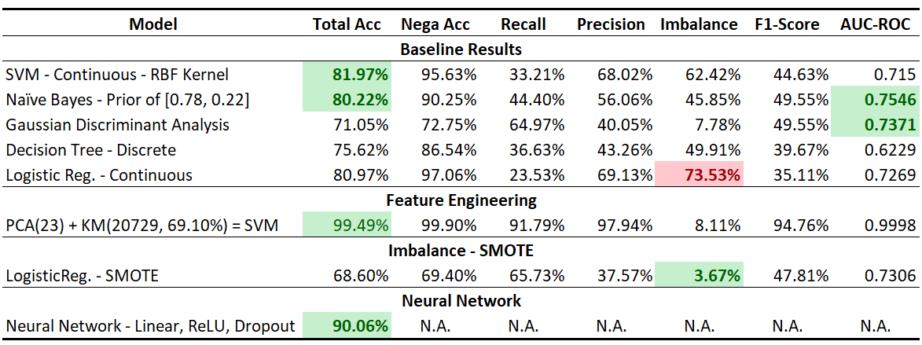
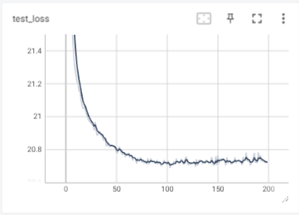
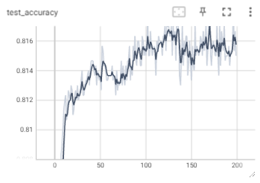
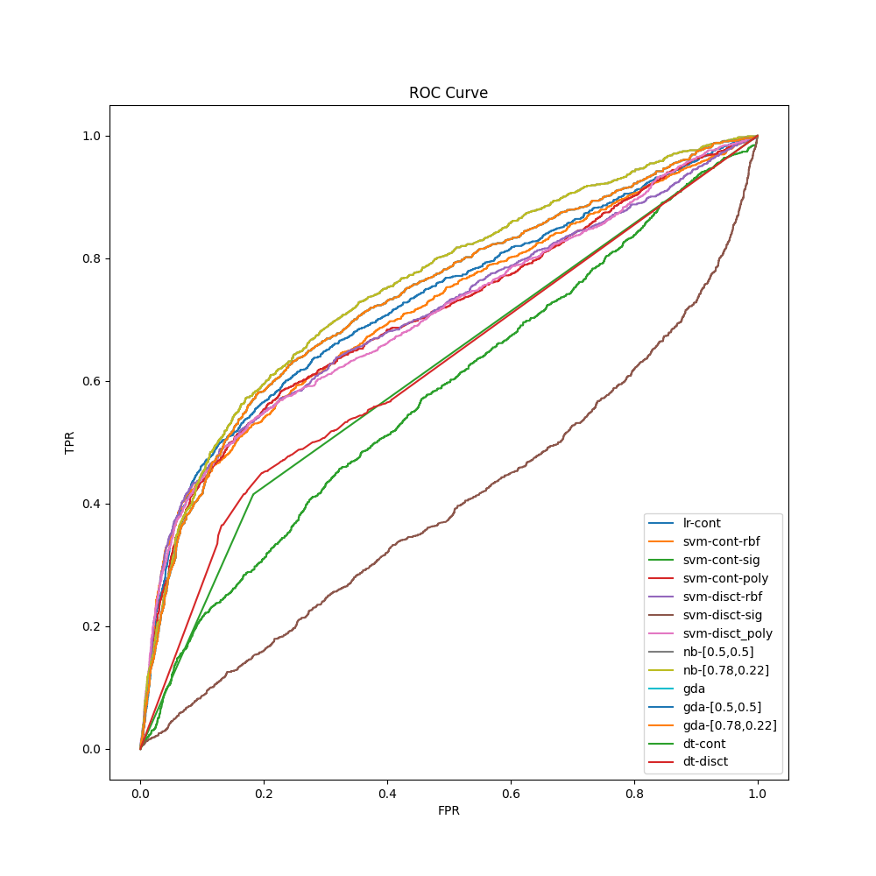
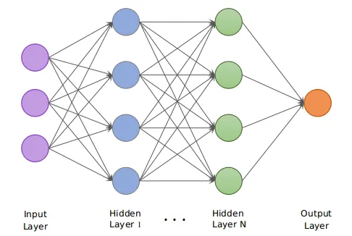
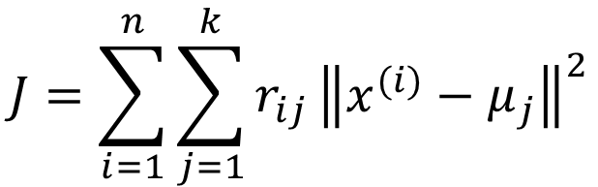
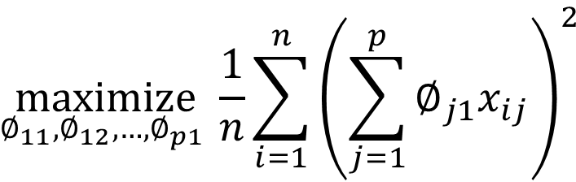
Big Mart Sales Prediction – Machine Learning Algorithms
Xinxie Wu, xinxiewu@gmai.com
Predicting
Dataset & Features: Big Mart Sales 2013
2-Part Methodology: Models & Workflow
In banking, Credit Risk is a big issue; Banks use various
Dataset has 30k observations, 6,636 (22%) default; includes 23 attributes covering demographic and card historical information. All features are used and further analyzed by PCA & K-means.
EDA:
No Missing Value – Reasonable Values
Normalization & Discretization (9 Categories)
Correlation Matrix – Marriage & Age (0.41)
Training vs Testing: 80% / 20%
Principal Component Analysis (23)
K-means (2)
$$\underset{∅_{11},∅_{12},…, ∅_{p1} }{maximize}{\frac{1}{n}\sum_{i=1}^{n}{{\left(\sum_{j=1}^{p}{∅_{j1}x_{ij}}\right)}^{2}}}$$
SVM re-training determines the optional # as 23
$$J=\sum_{i=1}^{n}{\sum_{j=1}^{k}{r_{ij}}{\left\|x^{(i)}−μ_{j}\right\|}^{2}}$$
Baseline Models
For baseline algorithms:
Continuous: SVM, with rbf kernel, achieves 81.97% accuracy; GDA reaches the highest AUC-ROC as 0.74, with F1 score 0.50.
Discrete: Naïve Bayes, with (0.78, 0.22) prior distribution, gains 80% accuracy; also, this NB reaches AUC-ROC as 0.76.
Logistic Regression shows the highest imbalance gap (73.5%)
Neural Network
Results & Discussion
Dataset is split into training (80%), validation (10%) and testing (10%).
Convolutional layer is NOT in this research.
Results & Discussion:
Baseline models show total accuracy ~80%, but >45% negative-positive gap;
SMOTE removes the neg-pos gap, but brings overfitting (68.60%);
PCA returns an optimal number as 23, K-means removes 9,271 obs. Improved SVM accuracy 99.49%;
Neural network includes 0.8 dropout and gets 90.06%; no convolutional layer in this research.
Future Work
References
For the future work, k-fold cross-validation is under consideration since our research focused on 8/2 dataset split. Also, neural networks with more different number of layers/neurons need to be trained and compare the performance. Finally, more feature engineering methods should be applied, and further performance comparison is needed.
[1] R. P and S. M, “Predictive Analysis for Big Mart Sales Using Machine Learning Algorithms,” 2021 5th International Conference on Intelligent Computing and Control Systems (ICICCS), Madurai, India, 2021, pp. 1416-1421.
[2] K. Punam, R. Pamula and P. K. Jain, "A Two-Level Statistical Model for Big Mart Sales Prediction," 2018 International Conference on Computing, Power and Communication Technologies (GUCON), Greater Noida, India, 2018, pp. 617-620.
[3] Keyaben et al. BigMart Sale Prediction using Machine Learning. International Journal of Innovative Science and Research Technology, Volume 6, Issue 9, September – 2021.

